Slide 1
Notes:
FACILITATOR NOTES:
The Welcome will vary if the OLM or another Dealership executive has opening remarks.
There is no script tied to this slide. It is displayed as participants enter.

Slide 2
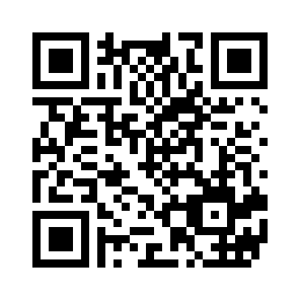
YOUR WORKSHOP PRE-TEST
Scan the QR code to begin the survey
or type in the following URL on your computer:
surveymonkey.com/r/NGAGEG315PreTest
Notes:
Direct participants to use the QR readers on their phones to take the pre-quiz:
Say:
Take out your phones and open the QR Reader app. [Explain how to access the code on screen.]
We’ll revisit these questions after the session.

Slide 3
FACILITATOR
[Insert Your Name]
Notes:
Introductions:
Begin with a brief Welcome:
Welcome to the newest NGAGE Customer Experience Workshop: “Exceptional Delivery Experience.”
[Introduce yourself and briefly describe your credentials.] It’s great to be back with you for our latest NGAGE Workshop.

Slide 4
NGAGE:
EXCEPTIONAL DELIVERY EXPERIENCE
Notes:
Before we go further, let me cover a few items:
Our workshop today will run until about (provide time). Everyone please remain in the room unless your manager specifically directs you to serve a customer.
Please set your phones to silent.
[Cover additional items as discussed with the OLM.]

Slide 5
TODAY’S WORKSHOP
We will discuss:
How an exceptional new vehicle delivery can improve our customer’s perception of his or her experience with us.
How to best leverage the NCAR app throughout the Delivery Process:
          Delivery Readiness (Pre-Delivery)
          Delivery
          Owner Services
          Customer Follow-Up
Notes:
Say:
Today, we’re going to talk about how an exceptional new vehicle delivery can improve the customer’s perception of his or her experience with us. We’re also going to review and practice how to leverage the Nissan Customer Acquisition and Retention (NCAR) app throughout the Delivery Process, including:
Delivery Readiness (Pre-Delivery)
Delivery
Owner Services
Customer Follow-Up

Slide 6
NGAGE: LEARNING OBJECTIVES
By the end of the session, you will be able to:
Identify the importance of conducting an exceptional new vehicle delivery.
Conduct a delivery using the NCAR app.
Notes:
Say:
This workshop will help you perform truly exceptional vehicle deliveries that will lead to increased customer loyalty and retention. By the end of the session you will be able to:
Identify the importance of conducting an exceptional new vehicle delivery.
Conduct a new vehicle delivery using the NCAR app.

Slide 7
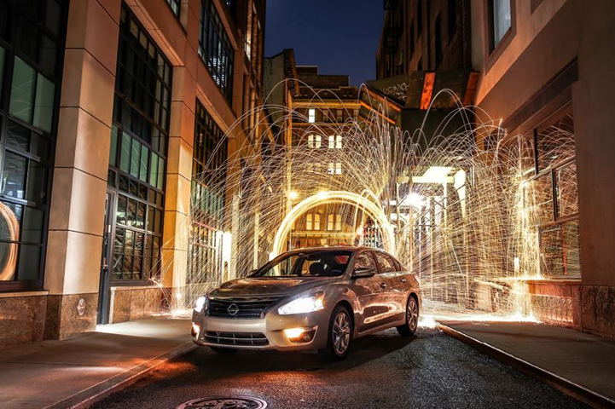
DEFINE “EXCEPTIONAL”
What does “exceptional’’ mean to you?
Notes:
Say:
Let’s begin with a discussion about the importance of an exceptional new vehicle delivery. We’re just getting started, and I’ve already used the word “exceptional” quite a few times. What does that word “exceptional” mean to you? [Take a few responses.]

Slide 8
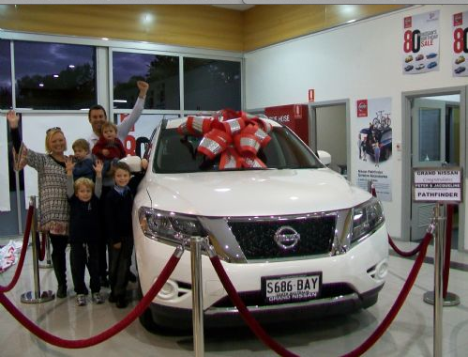
WHY EXCEPTIONAL DELIVERIES?
Why does the delivery experience have such an impact on the customer’s overall impression of his or her time with us?
Notes:
Ask:
Why does the delivery experience need to be _________? [Use the words that the participants used to describe “exceptional” and take a few responses.]
Why does the delivery experience have such a huge impact on the customer’s overall impression of their time with us?
Facilitator Note:
Facilitate a brief discussion, and record the participants’ ideas on a flipchart.
[Look for: It’s the last impression they take away from their purchase experience; The excitement of finally getting to take their new vehicle home; Should be the emotional high point of the process; Sensory experience—new vehicle smells, sights, sounds; etc.]
Say:
Those who are seriously building their careers as professional Sales Consultants know that Delivery may be the end of a “sale,” but more importantly, it is the beginning of a relationship. If you perform a professional delivery, be confident that it will lead to return service visits as well as additional vehicle sales—not only to the customer, but to their co-workers, friends, and family.

Slide 9
DELIVERY DRIVES SATISFACTION
Key Drivers of Overall Customer Satisfaction reflect the delivery experience:
  Did the Sales Consultant …
  Offer to pair/connect to Bluetooth?
  Offer to demonstrate Navigation?
  Review Service and Maintenance Guides?
  Offer to set up first service appointment?
  Contact after delivery to ensure satisfaction?
Notes:
Say:
An exceptional delivery is so important that it’s no coincidence that our Key Drivers of Overall Satisfaction all reflect elements of the Delivery experience:
[CLICK TO REVEAL EACH BULLET.]
Did the Dealership:
Offer to pair/connect phone to Bluetooth?
Offer to demonstrate Navigation?
Review Service and Maintenance Guides?
Offer to set up first service appointment?
Contact you after your delivery to ensure your satisfaction?

Slide 10

Key Drivers of
Overall Customer Satisfaction
Offer to pair/connect phone to Bluetooth?
126 Point
Difference
NSSI
Point
Increase
Notes:
Say:
Look at the impact on the NSSI score when the customer answers “YES” to each of these Delivery questions.
[Show each of the five slides.]
Our goal is a 90% or better “Yes” response rate. This will improve overall NSSI and help us all reach our incentives.

Slide 11
Key Drivers of
Overall Customer Satisfaction
Show you how to operate the Navigation System?
150 Point
Difference
NSSI
Point
Increase

Slide 12
Key Drivers of
Overall Customer Satisfaction
Review Service and Maintenance Guide?
156 Point
Difference
NSSI
Point
Increase

Slide 13
Key Drivers of
Overall Customer Satisfaction
Give you an overview of or introduce you to someone in the Service Department?
84 Point
Difference
NSSI
Point
Increase

Slide 14
Key Drivers of
Overall Customer Satisfaction
Did the Dealership contact you after your delivery to ensure your satisfaction?
108 Point
Difference
NSSI
Point
Increase

Slide 15
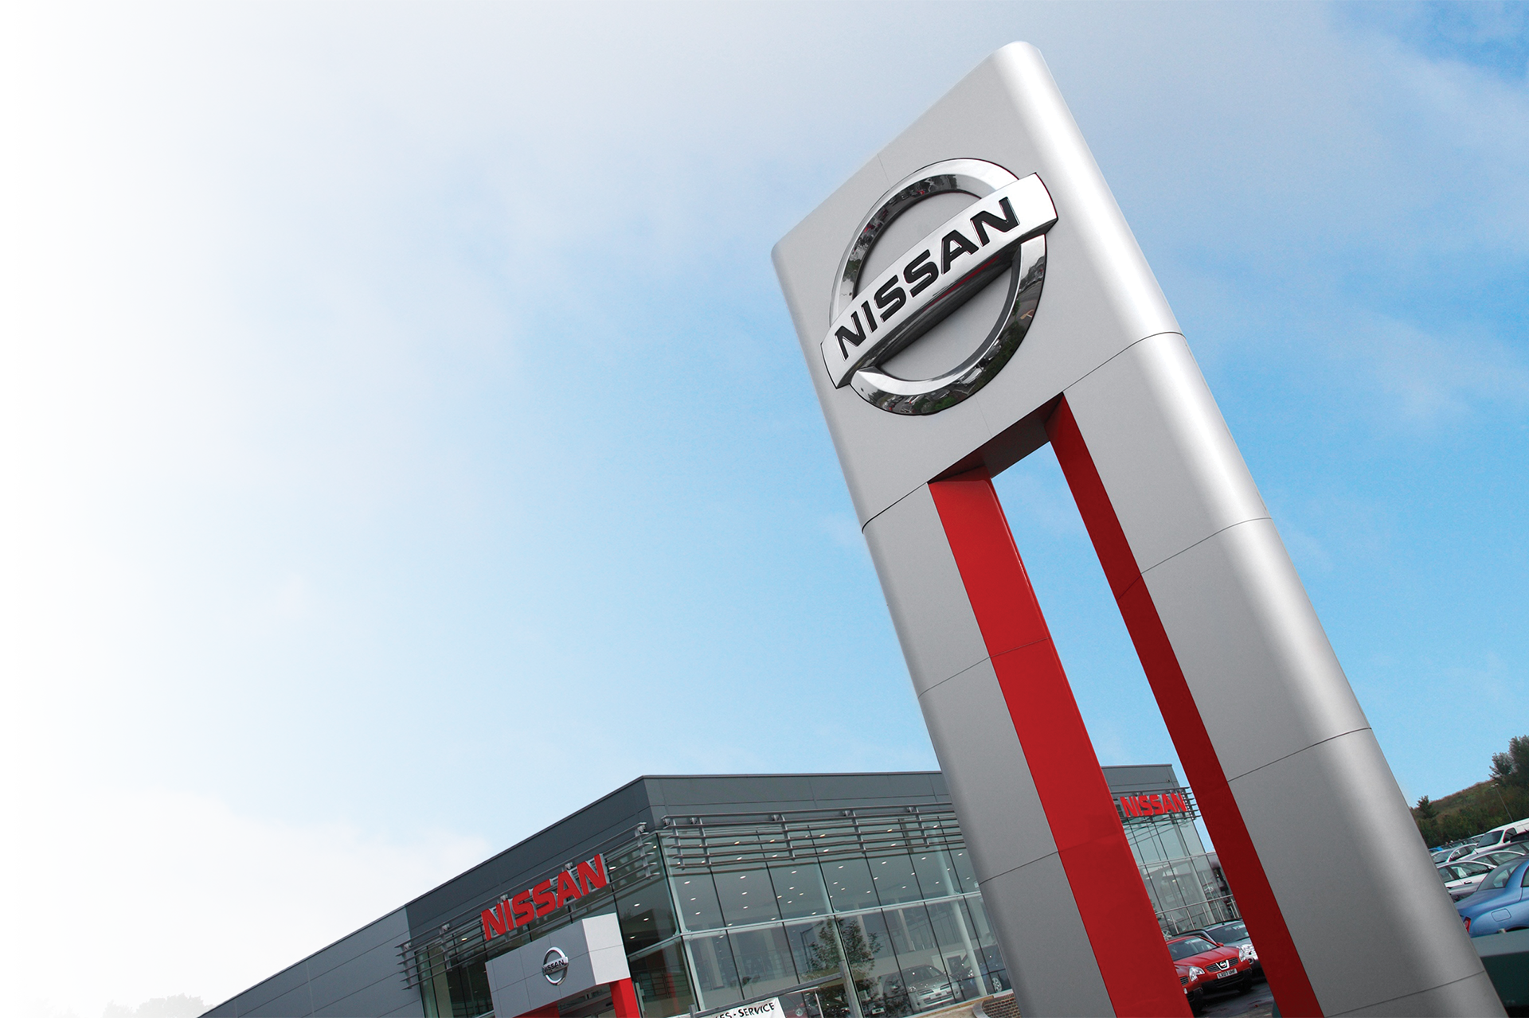
GET CUSTOMERS INTO
THE SERVICE HABIT
Regularly servicing customers are
5 X
more likely to return to the Dealership to purchase their next car.
Source: 10 Strategies for Sales and Satisfaction, Learning from SSI
Notes:
Say:
A positive experience at the Dealership is the single most important factor cited by customers as influencing their next purchase decision. During delivery, the sales-to-service transition is where the service experience begins.
And that’s important, since customers who regularly service their vehicles at your store are more likely to return when the time comes to purchase a new Nissan.
Ask:
How much more likely? [Take a few responses.]
Say:
Five times more likely.

Slide 16
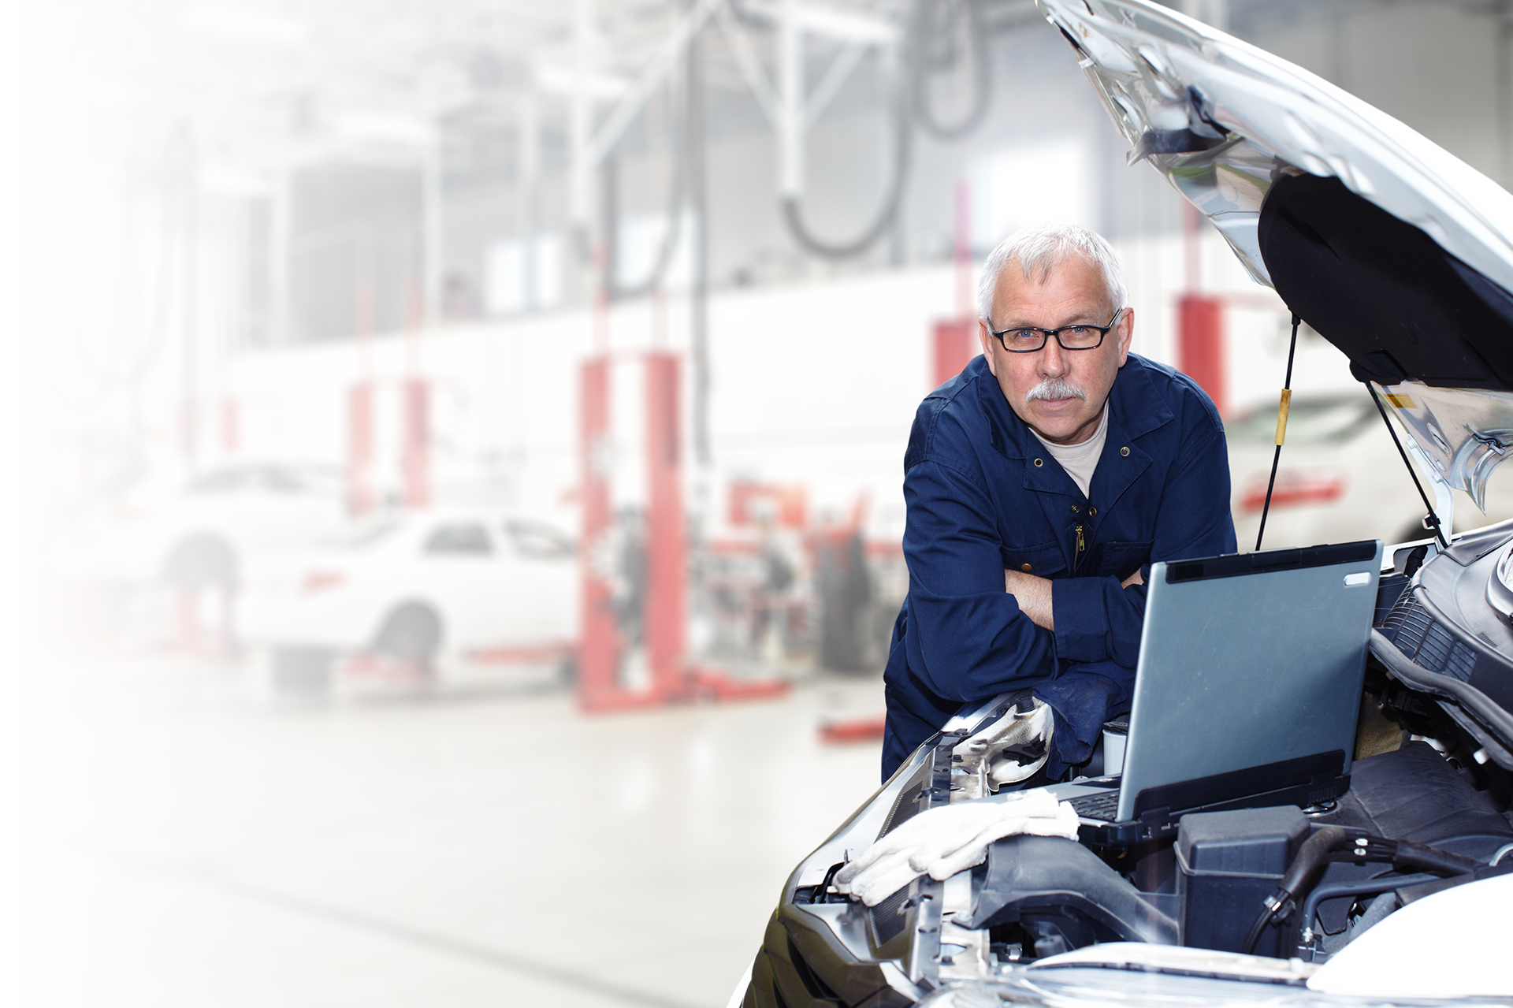
A QUALITY SERVICE TRANSITION
Introduce your Service staff.
Describe your Service Department amenities and the benefits of servicing here.
Notes:
Say:
That’s why a quality transition to Service is so critical! During your Dealership tour, it is important to highlight the amenities of the Dealership, introduce the Service Advisors and Manager, and explain the benefits of using your Dealership for service.
Ask:
What are your best practices for introducing your customers to your service department if it is closed? [Responses may include: leverage NCAR, take the customer on a tour, show pictures, set up first appointment using online service, etc.]
Can anyone tell me what service amenities this Dealership offers or give me a benefit of servicing your vehicle here?
[Responses may include: Saturday hours; Express Service; On-Line Service scheduling; free Wi-Fi; loaner cars or other alternate transportation; factory-trained technicians; free car wash; and service lounge amenities.]
Say:
If you concentrate on covering the Key Drivers of Overall Customer Satisfaction during every delivery, you are laying the foundation for a long and successful business relationship with your customers.
Next, I will show you how using the NCAR app enhances your ability to highlight the key drivers to make your deliveries even more exceptional.

Slide 17
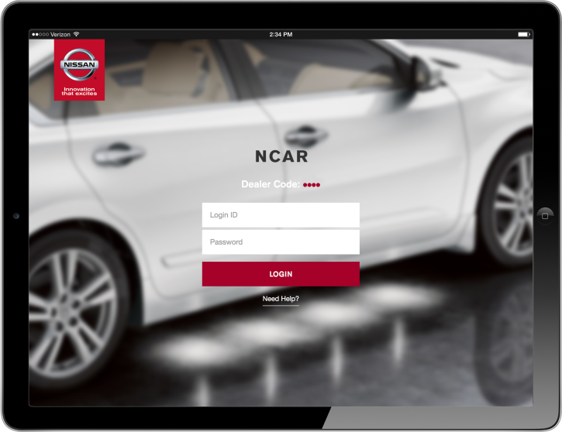
NCAR DRIVES THE
DELIVERY EXPERIENCE
Notes:
Say:
Nissan is committed to using the NCAR app as a tool to help every Sales Consultant and Delivery Specialist create a great delivery experience for customers.
Ask:
How many of you have delivered a new vehicle using NCAR? [Wait for show of hands.]
How many times have you used it? [Take several responses, and ask one of the biggest users to share their experiences.]
How did it go? What did you like about it?
[Allow for a brief discussion.]

Slide 18

TIMELINESS AND THOROUGHNESS
How much time does it take to score a perfect 10?
Notes:
Ask:
How much time do you think it takes to earn a score of 10 on the timeliness and thoroughness of delivery? [Take responses. There is no correct answer because it varies by individual.]
Say:
The great thing about an NCAR Delivery is that, by allowing the customer to select the features they want you to present, they will tell you just how thorough to be and how much time to spend!
The appropriate time for a delivery is exactly as long as it takes for your customer to understand the features, equipment, and accessories that are important to them.

Slide 19
NCAR CONSISTENTLY RATES HIGHER
NCAR Piloted:
April–May 2015
NCAR Launched:
July 15, 2015
Total NCAR Deliveries:
Over 100,000 Deliveries
NSSI
Point
Increase
NSSI Category
Source: NCAR FYTD statistics as of November 2015
Notes:
Say:
NCAR was created to give customers exactly what they want from the delivery experience. NCAR was piloted in April and launched July 15, 2015, and the numbers tell us that it is a process that customers prefer. NCAR has been outperforming non-NCAR deliveries in every category. Look at the statistics. In over 100,000 deliveries where NCAR was used by nearly 9,500 Sales Consultants representing 90% of our Dealer Network, NCAR Deliveries rate higher.
Overall NSSI: 969.1 (8.1 points over non-NCAR).
Delivery Index: 973.4 (10.8 points over non-NCAR).
When you use NCAR in the way that it is intended, you will touch on all of the Key Drivers of Customer Satisfaction at delivery, your overall NSSI score will increase—and so will your NSSI-driven bonus.
O Facilitator Note:
For your information, here are the additional results:
Thoroughness: 975.2 (13 points over non-NCAR).
Timeliness: 973.1 (11.8 points over non-NCAR).
Condition of the Vehicle Score (6.6 points higher for NCAR).
Scheduling 1st Service Score (4.3 points higher for NCAR).
Say:
These numbers are the average, but some of the more dedicated stores do even better.

Slide 20
NCAR SUCCESS STORY
Family Nissan of Laredo
85% NCAR Use in Aug. and Sept.
216 NCAR Deliveries
73 Surveys Received
37.2 Gain in NSSI
50.9 Gain in Delivery Index
Sales Process 27 Minutes Quicker
when NCAR Was Used
Notes:
Say:
Look at the success of Family Nissan of Laredo. During the months of August and September, when they used the NCAR app, their delivery process was 27 minutes quicker, and they gained 37.2 in NSSI and 50.9 in Delivery Index.
Ask:
Their overall sales process was shorter, but customers perceived the process as being more timely and thorough. How do you suppose that happened?
[The Sales Consultants were addressing only the features that the customers were interested in learning about.]

Slide 21

NCAR APPS
NCAR
NCAR-Training
Notes:
Say:
Wow! Those are impressive increases. With results like these, you will want to start taking full advantage of the NCAR app.
To help you do that, I will now demonstrate the Training version of the NCAR app. The Training version was designed specifically for Sales Consultants to practice using NCAR in a non-production environment.
*******************
Topic Two: NCAR Demonstration and Discussion
Facilitator Note:
Switch from your PowerPoint presentation to using the NCAR app for the demonstration.
Say:
The other NCAR app is the one that you will use with real customers during live deliveries, because any data that is generated in that app is going to be captured and loaded into the database.
It’s always a good idea to keep all of your Nissan apps in a folder on your home page so that you can easily access them.
I’m going to click on the Training app. Then the first step is to log in. You’ll need to put in your Dealer Code the first time. After that it will be stored. You’re going to use your NNA.net or Virtual Academy credentials as your username and password.
Ask: You all know yours, right?
Say:
I’m logging in. To do that, hit the login button, and this warning will pop up, letting you know that you are in the Training app.
Because we are in training today, we are going to say, “okay.”
Say:
This tab is the Customer Activity List. If you click on that it will give you up to 30 days of transaction-level history within the app. It will show you a list of all of the customers that you have used NCAR with in the last 30 days, where they are in the process, as well as what Sales Consultant worked with them. You all have access to your entire Dealership’s records.
Say:
Another thing to note regarding this tab is the last activity. Unless it says, “delivery completed,” it will not register as an NCAR delivery on your Sales Manager’s report. Today I will take you through exactly what constitutes a completed delivery.
Say
You can revisit any of your customers. For example, if a customer started the process and then had to leave you can just click on their name when they return.
Say:
I’m going back to the homepage. The “Home” button is the red Nissan logo on the top left.
Now let’s walk through the app as if you are working with the customer.
The first thing that you need to tell the app is what customer you’re working with. There’re a few ways you can do this:
You can type their phone number.
You can search by email address.
You can type in their first name, last name, street address, and zip code.
Any of these searches will link to the Nissan national database, not your Dealership’s database. NCAR doesn’t link to your CRM or DMS. Only customers who have previously purchased or serviced at any Nissan dealer in the country will show up.
Say:
We’re going to add a customer. My favorite way to do that is to scan the barcode on the back of their driver’s license. My state uses the bar code, as do most states. If you scan the bar code, all the information on the front will populate.
Always confirm with the customer whether the address information on their driver’s license is current.
So I’m going to scan my license using the “Barcode Scan” button all the way up on the top right.
Once you hit the “Barcode Scan” button, it will open up the camera function in your tablet. You don’t have to hit any additional buttons. You’re simply going to hold the barcode behind the camera until it focuses and catches.
If you have an old iPad 2, and it has a camera but does not have the auto-focus feature, it won’t be able to scan the barcode.
If you get a customer who is in the National database, They will be in the system, just hit “select.” If anything needs to be updated, do that by hitting the pencil button that is next to the customer’s name.
If the customer is not in the database, it will tell us to “Create a New Profile.” To create a new profile, you will need to add information to any of the fields that didn’t automatically populate when you scanned the customer’s license.
Say:
The customer is now loaded into NCAR!
Keep in mind that NCAR was created to mesh with your sales process. It’s not trying to dictate procedure, and so you can arrange the process anyway that it works for you. You can start anywhere that you like and use the “Pre-Delivery,” “Delivery,” and “Owner Service” tabs in any order that you want. You can even have two different tablets logged into the same customer and the same car at the same time doing two different steps of the process simultaneously. It’s up to you.
Facilitator Note:
You will demonstrate entering a VIN of a vehicle. You may use the same one that you will be using in the next exercise.
Say:
The most natural progression would be to begin with “Pre-Delivery.” I’m hitting the “Pre-Delivery” button, and it will ask me to tell the app what vehicle we’re delivering. There are a few ways to do that.
You can type in the 17-character VIN, but since that leaves some room for error I like to scan the barcode, which is on the corner of the Monroney label. It’s also on the driver’s doorjamb VIN plate in the vehicle.
To scan the VIN, you just hit the “Barcode Scan” button, and it will again call up the camera function on your tablet. We don’t need to hit any buttons; the tablet auto-focused and grabbed the image.
Say:
While the vehicle is loading, let’s talk about pre-delivery. There’s some misconception about what pre-delivery is, so I want to talk about that.
When the vehicle comes off the truck from our factory, it goes into your Service department and your technician does a PDI of the vehicle.
After the technician does a PDI, the vehicle may sit on your lot for 60 to 90 days before a customer comes in and says, “Hey, I want that one!”
A lot can happen in that time. The tires could be flat-spotted, or the battery could be dead. There could be tree sap on the hood. You may have stolen floor mats out of it a few weeks ago that haven’t been replaced. Regardless, you don’t want there to be any bad surprises when you deliver the vehicle. You want it to be perfect for the customer.
So Pre-Delivery is two things:
Verifying that the tech did what he said that he did on the PDI.
Making sure that the vehicle is in showroom-perfect condition.
Say:
So we started the process at “Pre-Delivery.” We scanned the vehicle, and you can see it’s a 2016 [Rogue or Maxima]. It’s going to give you all the details about the vehicle, including the color, the VIN number, and the package contents. You can actually click on a package to show what features are in that package just as a reminder that you are indeed on the correct vehicle.
Once you verify the VIN, you select that vehicle, and it will load for delivery. You can see in the top right that there are 11 items to be performed during pre-delivery.
Doing this part of the process is not customer-facing so it can be done by anyone. The checklist is 11 Yes/No questions that verify each item has been completed.
You may not know what some of the items on the list are, so we have included a “Learn More” button that you can click on to tell you how to verify that item has been completed before answering yes or no. I’ll give you an example.
Do you see the second one down that says, “TCU”?
Ask:
Without reading it, does anyone know? [Take responses.]
Say:
TCU stands for “Telematics Control Unit.” It’s an embedded cellular signal in the vehicles that have NissanConnect Services. You may have heard of OnStar by General Motors. That is their brand of telematics. NissanConnect is ours. The TCU embeds a signal in the vehicles that are equipped with NissanConnect Services so that the vehicle can communicate with the “heavens.”
It’s very important for you to know about the TCU because one of the things that it controls is automatic collision notification. If one of your customers buys a Platinum Maxima, drives off the lot and gets into a nasty accident, NissanConnect Services will alert the authorities and deploy them to the scene of the accident (unless the customer responds over the loudspeaker in the car and says that he doesn’t need assistance).
When vehicles come from the factory, the TCU is NOT turned on. It’s part of the technician’s job during the PDI to activate the feature.
Ask:
If the technician did not do that and the customer gets into a crash thinking that they have automatic collision notification, and then nobody shows up, who are they going sue? [Take responses.]
Say:
Everybody, right?
That’s just one example of how important that these steps are and a testament to why the checklist shouldn’t be pencil- whipped. We need to actually inspect these items.
Now if you are inspecting a vehicle and you notice that the TCU is not turned on, we don’t expect you to turn it on. You don’t know how to; but we do expect you to notify your service department so that they can get a technician to turn it on before the customer leaves.
The checklist is a simple Yes/No to each question—battery check, tire pressure, full tank of gas, etc. You then move on to an exterior inspection. Is the vehicle’s exterior clean and in showroom condition? If it has a scratch, you can’t say, “yes” in good faith, so I type in “No.” Anytime you type in “No,” you have to also type in why you said “no” and what you are going to do about it.
Say:
We have completed all 11 items and are ready to move on, but if for some reason, you need to stop prematurely, put it down, and come back to it later, you can do that by hitting the “Save for Later” button.
Once you hit the “Complete” button, it will take you back to the homepage of the dashboard, at which point, you can begin the “Delivery” or “Other Services.” Today, I am going to select the “Delivery” button.
Say:
I told you that NCAR wants to mesh with your sales process. “Delivery” is the only step in the process that might be a bit of a departure from the sales process that you know today. This is the step where you give the customer the ability to select the features most important to them so that you can review them during the actual feature presentation.
I’m going to put my app aside for a few moments because I want to talk about this.
Ask:
Right now, a customer gives you about 15 minutes to explain features, but it takes how long to properly deliver a vehicle that has a lot of features, like a Platinum Maxima? [Take responses.]
Ask:
Whatever the answer, there is a disparity. If the customer says, I’m going to give you 15 minutes, what do you do if it really takes an hour to do a proper delivery?
[Take responses.]
[Answers may include: “I choose the features that I think the customer may want to know about”; “I reschedule when the customer has more time”; “I tell them to call me if they want more explanation in the future.”]
Ask:
If you are asking customers in a rush to come back, do they do that?
[Take responses.]
Say:
Some Sales Consultants think that going over the feature during the sale is enough, so they throw the customer the keys, and say, “Call me if you need me.”
Other Consultants hold the customers hostage and talk about all the features whether a customer has the time and wants to hear about them or not.
Some Sales Consultants only talk about features that they know and they cover those features in most every delivery. Others go over only “what’s important,” in which case, I ask, “How do you know what’s important?”
The only way to really know is to ask, but how do customers know what they don’t know? This may be their first Nissan. If they never had a vehicle before with this much technology, how do they know what they need help with?
The only answer is to show them a list of features that is VIN-specific. When you use the NCAR app, only the features that are specific to the vehicle that the customer is buying will be listed for the customer to select from.
Say:
The “Feature Selection” tab will be used next in the process. This is the point where you sit your customer down at your desk and hand them your tablet and ask them to select the features that they would like to learn more about.
You don’t need to be there while they do this. You may have paperwork for F&I, and you have to go and inspect the vehicle, so it’s okay to sit them down with the tablet, and let them review the features that they would like you to review later. Ask them to put a checkmark next to those items. Explain that there are “Recommended Features” and “Additional Features.”
Say:
Recommended Features are those that we know customers need a little more help with. The customer would simply open each category and put a checkmark next to the features that they want to know more about. If they open the “Audio and Entertainment” category, for example, the first feature that they see is “Streaming audio via Bluetooth.”
There are a few reasons why the customer may not decide to check a box:
They may never want to use that feature.
They don’t care about the feature.
They are already savvy about that feature because they have used it before, have already done their homework, or because you have already explained it sufficiently during previous steps of the sales process.
The customer then moves on to “Safety Features.” They had Blind Spot Warning on a previous vehicle, so they don’t check that, but they are interested in the Moving Object Detection and watch the video.
Several of the features offer videos. Most customers find that watching the videos offers sufficient explanation, and they choose not to select that feature for you to review later. We find that the videos really save you time, allowing you to get to the next customer and next commission more quickly.
Say:
The customer has finished selecting “Recommended Features” and moves on to “Additional Features” by hitting “Next.”
Now let’s say that this customer’s hot button is safety. That’s why they are buying a Nissan. They open the “Safety Features” category, and they see the LATCH system. “My wife is pregnant with our first child. I definitely want to know more about that.” They watch the video, but still have a few questions, so they select that feature for more explanation, and then watch the Dynamic Stability Control video.
They complete “Feature Selection” and hit the “Save” button.
The app directs them to hand the tablet back to a Dealership staff member. To move forward a password is required. The password is the same for everyone. It is “delivery.”
The reason why this is password-protected is because it is the only customer-facing portion of the app, and you don’t want the customer to see any proprietary information or some of the things that you may have typed in during “Pre-Delivery.”
When you get the tablet back, you put in the password, “delivery,” and hit the “Next” button. At this point it will ask you if you want to go back to the dashboard or go to “Feature Presentation.” For the sake of time, we will go directly to “Feature Presentation.”
“Feature Presentation” is what you all know today as “Delivery.” This is when you and the customer are at the vehicle, and you are going over features in the vehicle. The big difference is that when you use NCAR, you only review the features that your customer wants you to review.
And so, you can see in the top corner, there are a number of conversations that you need to have with the customer. You can cover those items in any order that you like. You open up the first and say, “Mr. Customer, I see that you wanted me to go over Bluetooth Streaming Audio with you.” You then review the feature, and once the customer understands it, you check it off and then move on to the next feature.
The customer asked you to talk about Bluetooth. There are tips written into the app for items that are strongly recommended or difficult to explain. Maybe it’s been awhile since you had to explain that feature, so review the tips to make sure that you are covering the item properly. Bluetooth happens to be a very “hot” item, and there are lots of tips written here.
Any videos that appear under “Feature Selection” will carry over to “Feature Presentation” enabling you to show the video when you are doing the delivery. The videos can be very helpful, particularly when features are hard to demonstrate. The videos can do a much better job than you can do with words.
So once you have a conversation about each feature, check them off, or have the customer check them off.
Say:
At the bottom there are always two conversations to have:
Review of the Owner’s Manuals and Guides
Introduction to your service department.
We talked about the intro to service earlier. Talk about why your customer should be servicing at your Dealership and give them a tour of your facility.
Definitely make sure that if the service department is open that you introduce the customer to your service staff and, if it is closed, show them pictures of your staff and how to navigate the website, etc.
Say:
We have completed all of the required items. Now I want to show you two buttons at the bottom. These are here for two different scenarios. You told me that a lot of times that your customer is in a rush and will sometimes come back two to three days later to finish delivery.
So let’s say that a customer selected 20 items that they want you to review, and you have only gone through 10 of those items when the customer says, “This is taking longer than I expected. I have to go pick up my daughter. I will come back in a few days to go over the rest.” That’s when you would use this button, the “Save for Later” button. Then when the customer comes back, you can pick up where you left off.
Say:
Another scenario—Let’s say the customer selects 20 items, but after you’ve done 10, they say, “Ok, I’ve heard enough. I’ve got to go, and I’m not coming back.” You would select the “Partial Feature Presentation” button. That button allows you to prematurely complete the delivery. Don’t abuse this. Only use this feature if a customer wants to stop and says that they are satisfied with what you have presented.
Say:
Today we have completed all of the presentation items, so we will select “Yes, I certify that all items have been reviewed with the customer.” We then sign inside the signature box below the statement.
Next you would pass the tablet to the customer who checks the “Yes, I was given the ability to select the features that I wanted to learn about” box and signs inside the signature box.
Once you hit “Complete Delivery,” a copy of the delivery record will be deployed to whatever email address was in the email address field. It may not be the same address as on the RDR. If the customer doesn’t have an email address or doesn’t want the delivery record, you can unselect the blue box. When you are setting up the customer profile, that field is mandatory. If the customer doesn’t have one, type in none@none.com.
My customer wants a delivery record, so at this point, I hit “Submit.”
Say:
The last tab that I’d like to talk about today is “Owner Services.” We will go back to the dashboard and then click “Owner Services.”
Ask:
Do you know what “Owner Portal” is? The best way to describe “Owner Portal” is that it is the virtual Nissan garage for your customers. They can use it to park all of their Nissans on the web, and from there they can access certain items and applications about their vehicles. One of the items that can be accessed there is NissanConnect Services. As more and more vehicles become equipped with NissanConnect Services, it will become more and more imperative to set your customers up with an Owner Portal account.
NCAR is able to populate all of the information automatically. You may need to tell it which phone number is the primary and secondary, but that is all. Once you do that, you hit, “Register,” and the customer agrees to the consent, and so on.
Say:
If you click on “Additional Services” in the top right corner, an opportunity to schedule the customer’s first service appointment will appear. If you click on this, it opens a browser outside of the app, and it directs you to whatever your Dealership’s service-scheduling URL is.
So we click on it and it takes you to the link that you have to schedule service, and you know what to do from there.
I should note that in order to be designated as a completed delivery, “Owner Services” and “Scheduling the First Service Appointment” are recommended but optional. You don’t need to do those for a delivery to be designated as complete.
Say:
There are just a few more things that I want to show you. “View Delivery Confirmation” is where you can get a copy of what the customer receives via email.
This document will list only the features that the customer selected, not all of the features on the vehicle. You can use this document when you do your follow-up call, or when the customer comes back in for their first service appointment to reconnect with them and let them know that you remember them.
Say:
The final piece that I’d like to show you is the email that the customer receives from your Dealership.
Ask:
Do you see where it says “Download Delivery Confirmation”? That is where the customer can download the delivery confirmation. They can then save it to their desktop or print it. It contains three links.
The first link is for how-to videos. This is a warehouse of videos, accessible as a separate app on your phone and it can also be downloaded onto the customer’s phone. It’s called the Nissan Quick Guide, and if you haven’t already downloaded it, I highly recommend that you do it before the end of the day. You download it the same way that you would any app.
The second link is for electronic access to Owner’s Manuals and Guides for their vehicle: https://owners.nissanusa.com/nowners/navigation/manualsGuide
The third link is to your Dealership’s homepage.
*************************
Topic Three: Practice Making Exceptional Deliveries
Say:
Now that you have seen an NCAR demonstration, I’d like to give everyone a chance to practice delivery using the app. Let’s go through the process together as a group. I will be your customer and each of you will take a turn practicing part of the process with me. We will again be using the Training Version of the NCAR app, as you always should when you are practicing.
Say:
Let’s start by entering my information into the app. I am a new customer. I’d like a volunteer to come forward and enter my information into the app. [You may also draft someone to do this if you prefer.]
[Allow the volunteer to scan your driver’s license or manually enter your information.]
Say:
Thank you. While I’ve got you up here, I’m also going to have you enter in the vehicle information. I am purchasing [name the vehicle that you have reserved for training]. Here is the VIN. [Either hand them the Monroney sticker, a photo of the VIN scan, or the VIN number that you have previously written down.]
[Volunteer will enter the VIN.]
Thank you.
Say:
Next, I’d like another volunteer to go to the Pre-Delivery Step and complete the delivery checklist for my vehicle. By the way, there is scratch on my left front wheel. Otherwise, everything is perfect.
Ask:
How do you know if the TCU is turned on? [Take responses.]
[The SOS button light will be green when the car is on, and the Wi-Fi bars over the car icon on the touch-screen will be blue.] [Volunteer will complete the checklist.]
Thank you.
Say:
Now that the checklist has been completed, let’s move on to ”Feature Selection.” I know that I said that I was going to play the customer, but for this step I’d like each of you to be the customer, and select a feature that you would like to learn more about. Maybe it’s a feature that is hard to explain or one that you don’t fully understand. We will practice explaining the features that you select during the Feature Presentation phase of this activity, and we will be using the actual vehicle when we practice Feature Presentation.
You may select a feature from either the Recommended Features tab or the Additional Features Tab. It’s up to you.
Facilitator Notes:
Invite each participant to come forward and select a feature that they would like someone to demonstrate during Feature Presentation.
You may need to limit the number of features selected depending on available time and class size. For example, if there is limited time or a large class, you can limit the number of features selected. On the other hand, if you have ample time or the class is small, you can have participants select multiple features.
If anyone selects a feature that has a video presentation, ask him or her to hit “Show Video” as a customer would, and run a few seconds.
If no one selects NissanConnect Services, NissanConnect Mobile Apps, Bluetooth, or Navigation, please select those features as well.
Say:
To move onto the next step, we need to enter a password.
Ask:
Who remembers the password for the NCAR Training app? [Take responses.]
[Enter the password “delivery”.]
Ask:
Who can tell me how many features have been selected?
[Take responses. Info is at the top right of the screen in the black bar. ]
Say:
Yes, we as a group, acting as the customer, selected the features that will be covered in vehicle delivery. We have ___ [number] features to present today.
I am going to divide the features among you. If you know that you do a good job presenting one of the selected features, please volunteer to demonstrate that one.
By the way, volunteers, you will get a chance to practice explaining the feature before you have to do it in front of the class, so don’t be shy!
[Go through the selected features one by one and get someone to volunteer for each one.]
I also need a volunteer to present the Owner’s Manuals and Service Maintenance Guides to me. [Get a volunteer.]
And I need someone to introduce me to your service department. [Get a volunteer.]
Facilitator Note:
If no one volunteers to explain a feature, skip it and return to it (them) at the end.
Say:
I noticed that no one wanted to demonstrate [name the features not selected].
Ask:
If you don’t know how to demonstrate a feature that a customer would like to learn more about, what should you do? Where would you find the information to be able to help them?
[Take responses. You are looking for Virtual Showroom on VA, Owner’s Manuals, print QRG, or eQRG.]
Facilitator Note:
Depending on the number of remaining features/participants, break participants up into pairs or small groups and assign each group/person one of the selected features that no one volunteered to present. Tell them that they need to research the assigned feature and elect someone from their group to present it to you (the customer) during Feature Presentation.
Small Group Practice
Say:
Now we will go to the vehicle and practice our Feature Presentations. When you get to the vehicle, you will have eight minutes to work together to practice explaining the features that you volunteered to present and the feature that you were assigned to present. While preparing for your Feature Presentations, remember to use the available resources such as Virtual Academy and the eQRG or Quick Guide app.
After that, one by one, you will present your features to me. Then [name the volunteer] will present the owner’s manuals and finally [name the volunteer] will introduce me to the Service Department.
Ask:
Is everyone clear about what they are supposed to do?
Say:
Follow me to [name location of the vehicle]. If you have a tablet, please bring it with you. We are on a tight time schedule so please don’t make any stops along the way.
[Bring your tablet and walk group to the vehicle.]
[Arrive at vehicle.]
Say:
You have eight minutes to prepare your Feature Presentations. Time begins now.
Facilitator Note:
Walk around and check on each group or person to make sure that they are finding the information needed to explain their assigned feature and that they are working well together.
While participants are practicing, roll down the car windows in preparation for the presentations.
After 8 minutes, call time and thank them for using their time well and tell them that you are excited to see their presentations.
Say:
Everyone should gather around the vehicle so that you can hear each presentation. Feel free to sit in the back seat.
When it is not your turn to present, please listen carefully to pick up tips that you can use to strengthen your deliveries. It’s always helpful to hear how someone else presents something.
Those presenting should take your cues from me (the customer). You need to be as thorough and spend as much time presenting your feature as I require. As we discussed earlier, every customer is different.
Ask:
If I am the customer, where should I sit?
[Get the participants to tell you that your place is in the driver’s seat.]
Say:
Let’s now go through each of the features that I have selected in the order that they appear on the NCAR app which means that [name participant] who has volunteered for the [first feature] will go first. He (or she) will invite me to participate in Feature Presentation and then present the first feature. The rest of the presentations will follow.
Facilitator Notes:
One by one, the participants will present their features.
Next invite the person who volunteered to present the Owner’s Manuals to take their turn.
Finally invite the person who volunteered to introduce you to the Service Department to present.
After the last presentation…
Say:
Wow! Great job everyone. I am impressed.
Activity Debrief
Ask:
Was that an exceptional delivery, worthy of a perfect score of 10? [Take responses.]
What was exceptional? [Take responses.]
Did you see or hear anything that could have been improved? [Take responses.]
Did that delivery address all of the five Key Drivers of Overall Satisfaction?
***************************
Wrap-Up: Quiz/Survey
Facilitator Note:
Escort the group back to the classroom.
Say:
Today we have looked at what makes for an exceptional new vehicle delivery. You have practiced the entire Delivery Experience using the NCAR app, and you have picked up some tips to make every delivery an Exceptional Delivery Experience.
Ask:
What did you learn today that you want to incorporate in your next delivery? [Take 3–4 responses.]

Slide 22
Needs Assessment
Q9A. Helping you find the vehicle that best met your needs?
NSSI
Score
Truly
Customer Score
Source: Nissan Owner First Survey, Apr ’15–Nov ’15 Data
Notes:
Say:
Before we wrap up, there is one other item identified in our JD Power results that you have the opportunity to positively impact for a customer. Customers want a sales consultant to show genuine interest in discovering the features and qualities they seek in a vehicle.
Take a look at these numbers. To best meet the customers' needs… (NEXT SLIDE)

Slide 23
Needs Assessment
Q9C. Showing a genuine interest in you?
NSSI
Score
Truly
Customer Score
Source: Nissan Owner First Survey, Apr ’15–Nov ’15 Data
Notes:
… and to convey genuine interest, we need to conduct a thorough and thoughtful Needs Assessment. The impact to the overall satisfaction score is obvious, and it has also been noted to impact the vehicle gross.
A thorough needs assessment helps you throughout the sales process. It is integral to vehicle selection, it brings focus to your presentation, and it allows you to tailor a demonstration drive route that highlights what is important to the customer.
If you need some suggestions on the types of questions to ask during the Needs Assessment, log into Virtual Academy where we have the key questions you should be asking.

Slide 24
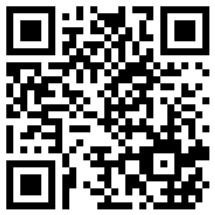
YOUR WORKSHOP EXPERIENCE
Scan the QR code to begin the survey
or type in the following URL on your computer:
surveymonkey.com/r/NGAGEG315PostTest
Notes:
Say:
Before leaving, we are again going to use the QR code readers on our devices.
Here is a second QR code that will take you to another short quiz and an evaluation of this workshop.
Your feedback is very helpful in making sure these NGAGE sessions are useful for you.
I’ll give you a few minutes to complete this now.
Facilitator Note:
Tell the participants how to access the QR code.

Slide 25


THANK YOU
Notes:
Say:
Thank you all for your participation today. I will look forward to seeing you all for the next NGAGE session.

